Slide 1
Big I CT, Big I NY, Big I NJ Affinity Introduction

Slide 2
HR Support
Recruiting
Organizational Development
Compensation
People Management Challenges
Member Services

Slide 3
Contact@AffinityHRGroup.com
www.AffinityHRGroup.com
877-660-6400
www.AffinityHRGroup.com/BigINY
www.AffinityHRGroup.com/BigICT
www.AffinityHRGroup.com/BigINJ
Connect With Us!

Slide 4
Association Partners
Big I NY
Big I CT
Big I NJ
IIAV
Big I National
Print, Tag & Label, Promo, Janitorial,
Pension Administration, Carwash, Oil Change, Wholesale Lumber, Building Materials,
Floor Covering, Paper Trade, Demolition

Slide 5
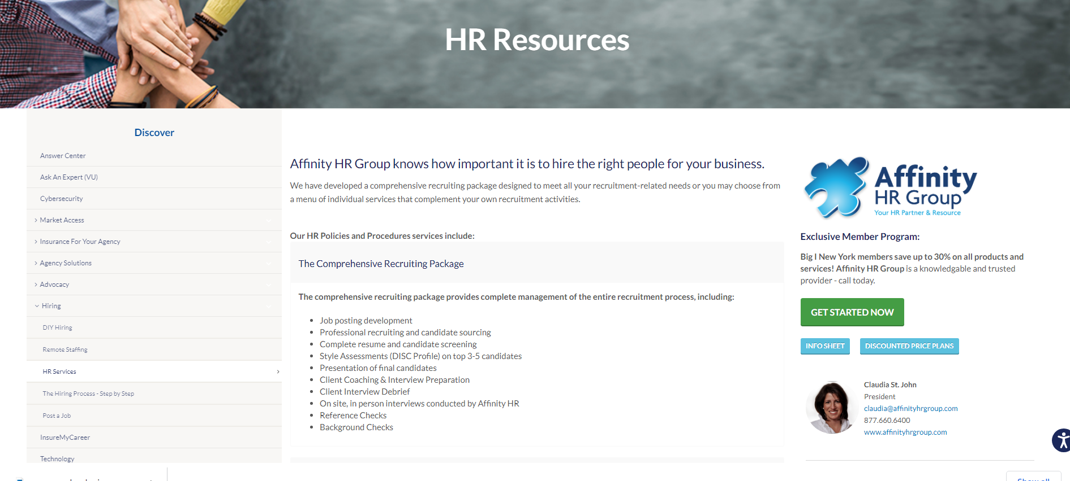
www.biginy.org/discover/Pages/Hiring
www.bigict.org/Discover/Pages/Hiring
www.biginj.org/Solutions/Pages/Hiring

Slide 6
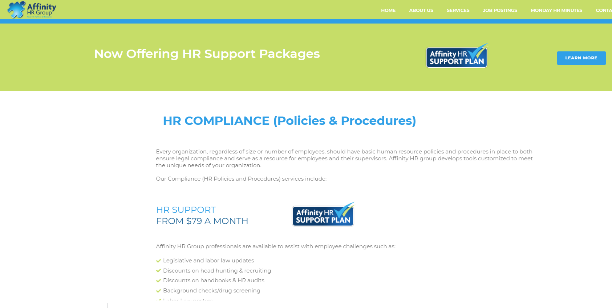
AffinityHRGroup.com/BigINY
AffinityHRGroup.com/BigICT
AffinityHRGroup.com/BigINJ

Slide 8
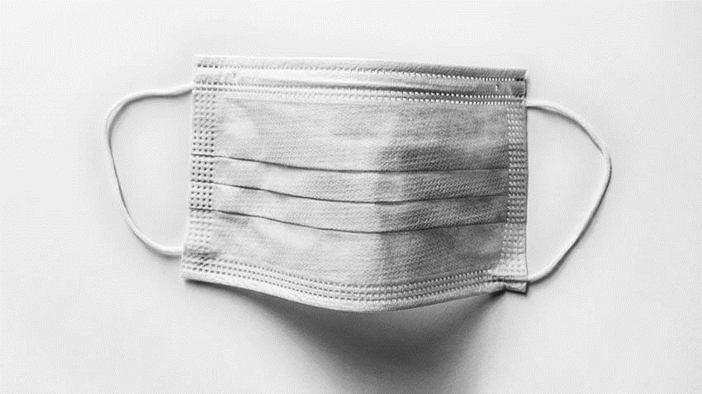

Slide 9
New CDC Mask Guidelines
Dropped Mask Mandate for Fully-Vaccinated Individuals
In all instances except healthcare, public transit
Unless state/local ordinances are in effect
NY & CT relaxed mask mandate for vaccinated individuals
NJ relaxed mask mandate for all individuals
Unless employer/workplace maintains mask mandate
Masks “Encouraged” For Unvaccinated Individuals, Required in NY & CT

Slide 10
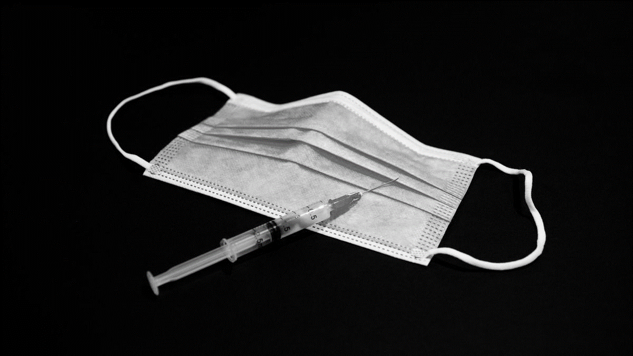
Advice To Agencies
Evaluate Your Workforce
What % Are Vaccinated? Who Isn’t and Why?
Encourage Vaccines
Maintain Safe Workplace (sanitation, kitchens, etc.)
Establish Policies/Procedures
Mask Mandates/Vaccine Requirements/Social Distancing
Remote Work Requests
Legal Compliance (OSHA, Hours, Leave, WC/UI/Tax)
ARPA & COBRA Compliance
State Compliance

Slide 11
Questions?
Claudia@AffinityHRGroup.com
www.AffinityHRGroup.com
877-660-6400
www.AffinityHRGroup.com/BigINY
www.AffinityHRGroup.com/BigICT
www.AffinityHRGroup.com/BigINJ

